Slide 1



Sixth Semester
Essentials of Management
HUM-4001
Dept. of Humanities and Management,
Manipal Institute of Technology - Manipal

Slide 2
Planning can be defined as a basic management function which enables one to select the purpose of the business, and how the resources should be mustered to achieve that purpose to include using the available resources optimally to do that.
Planning implies goal setting for the organization keeping in mind the constraints, opportunities, and threats as much as what the person or business which is planning wants to do.
Thus, a plan is a blueprint for goal achievement, a blue print that specifies the necessary resource allocations, schedules, tasks, and other actions to achieve the purpose.

Slide 3


Reasons for Planning – Why Plan?
Reduces Uncertainties
Provides Direction
Minimizes impulsive & arbitrary decisions
Planning bridges the gap between where we are & where we want to be
Resource Allocation
3

Slide 4
A goal is a desired future state that the organization attempts to reach.
Goals are important because an organization exists for a purpose, and goals define and state that purpose.
Goals specify future ends; plans specify the means to do that.
The method we choose to achieve the vision and execute the mission is planning. Therefore, planning is about looking ahead.

Slide 5
Planning answers six basic questions in regard to any activity:
What needs to be accomplished? What are the alternative routes to it?
When is the deadline?
Where will this be done?
Who will be responsible for it?
How will it get done?
How much time, energy, and resources are required to accomplish this goal?

Slide 6
Planning is important for the following reasons:
It helps the management to clarify, focus, and research their businesses or project's development and prospects.
It provides a considered and logical framework within which a business can develop and pursue business.
It offers a benchmark against which the actual performance can be measured and reviewed.
It plays a vital role in helping to avoid mistakes or recognize hidden opportunities.
In the business context, it guides the development of products, management, finances, and most importantly, markets and competition.
It helps in forecasting the future and makes the future visible to some extent.
It bridges between where we are and where we want to go.

Slide 7

STEPS IN PLANNING :
Being aware of opportunities
Setting objectives or goals
Considering planning premises
Identifying the alternatives
Comparing the alternatives in the light of the goals sought
Choosing an alternative
Formulating the supporting plans
Numberizing the plans by making budgets

Slide 8
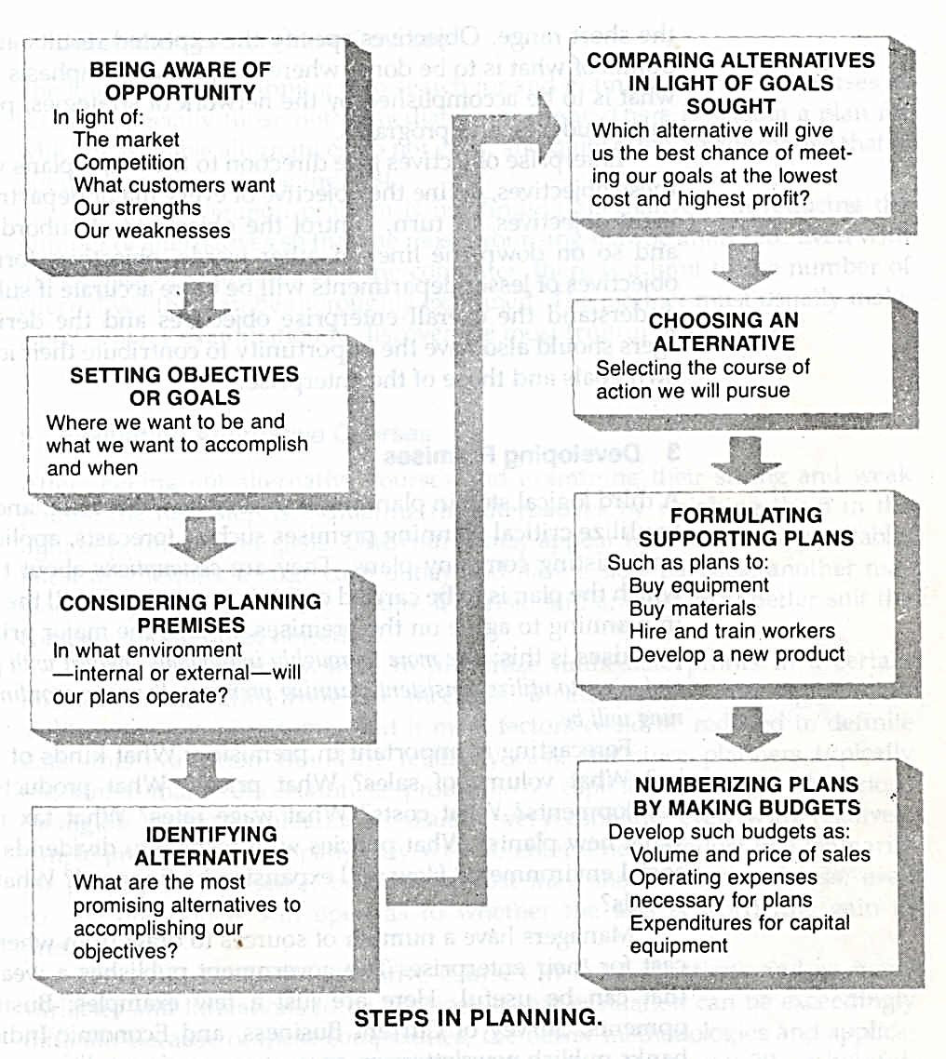

Slide 9
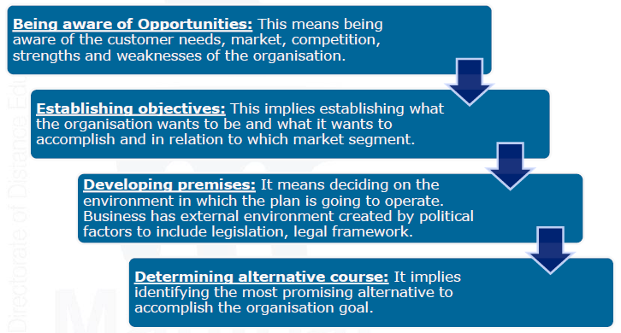
Steps in Planning

Slide 10
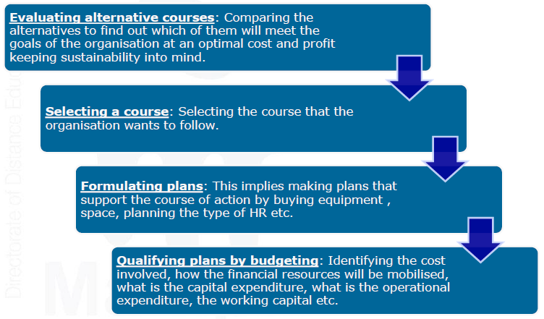
Steps in Planning

Slide 11
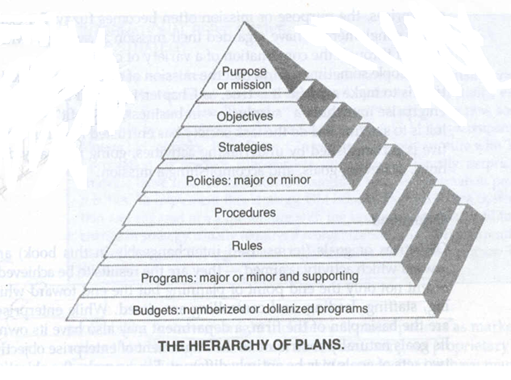
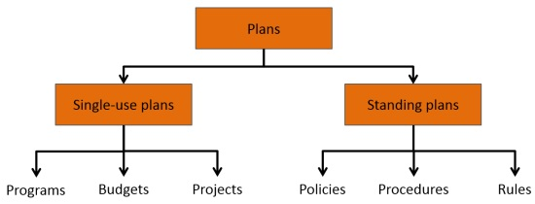
TYPES OF PLANS :
Purposes / Mission/Vision
Objectives
Strategies
Policies
Procedures
Rules
Programs
Budgets
BOARD OF
DIRECTORS
TOP LEVEL
MANAGERS
MIDDLE LEVEL
MANAGERS
FIRST LEVEL
MANAGERS

Slide 12
Mission
It identifies the basic function or task of an enterprise or agency or any part of it. Example:
Mission Of Oil Company : Are To Search For Oil And To Produce ,Refine, Market Petroleum Product.
DUPONT Company – Better Thing Through Chemistry.

Slide 13
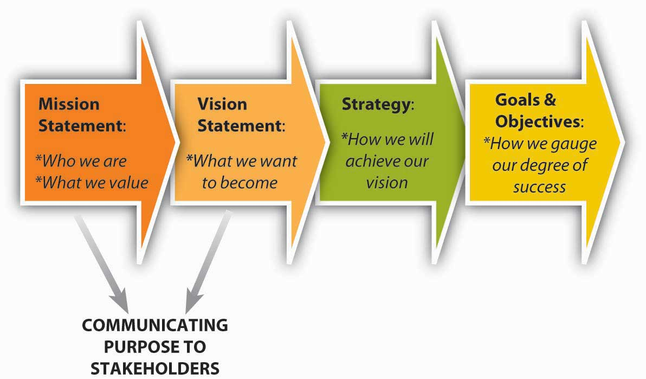
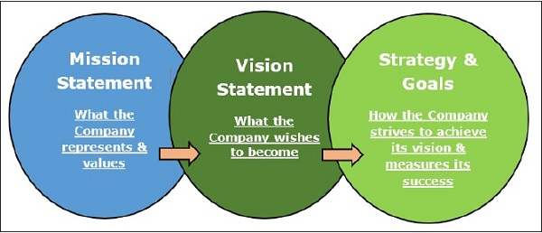

Slide 14
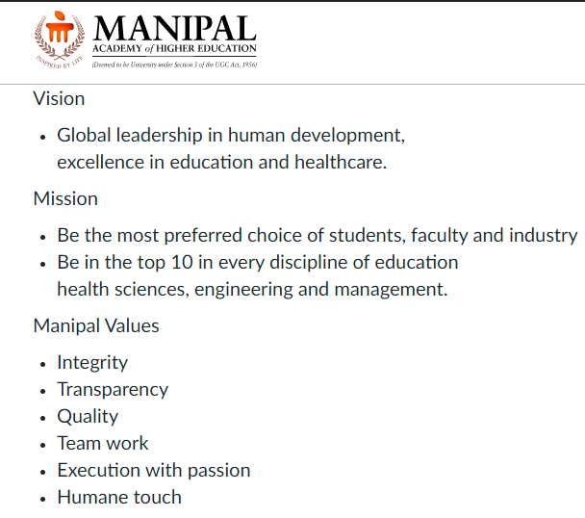

Slide 15


Slide 16
BOARD OF
DIRECTORS
TOP LEVEL
MANAGERS
MIDDLE LEVEL
MANAGERS
FIRST LEVEL
MANAGERS

Slide 17
Objectives
OBJECTIVES ARE DEFINED AS THE IMPORTANT ENDS TOWARDS WHICH ORGANIZATIONAL AND INDIVIDUAL ACTIVITIES ARE DIRECTED
VERIFIABLE OBJECTIVES-FACILITATE MEASUREMENT OF THE SURPLUS AS WELL AS THE EFFECTIVENESS AND EFFICIENCY OF MANAGERIAL ACTIONS
Overall objectives of a University
ATTRACTING HIGHLY QUALIFIED STUDENTS
OFFERING BASIC TRAINING IN PROFESSIONAL FIELD
GRANTING PhD degrees
New knowledge through research
Operating school through tuition, gifts of alumni and friends

Slide 18
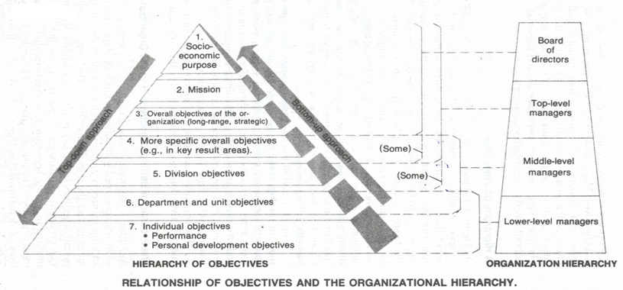
TOP DOWN APPROACH –UPPER LEVEL MANAGERS DETERMINE THE OBJECTIVES FOR SUBORDINATES.
BOTTOM UP APPROACHES –SUBORDINATES INITIATE THE SETTING OF OBJECTIVES FOR THEIR POSITIONS AND PRESENT THEM TO THEIR SUPERIOR.

Slide 19
POLICIES
Policies are also the plans in that they are general statements or understanding which guide or channel thinking in decision making.
Not all policies are statement, they are often merely implied from the actions of managers.
Eg– the practice of promoting from within.
Polices define an area within which a decision is to be made and ensure that the decision will be consistent with and contribute to the objective.
They help decide issues before they become problems.
EXAMPLES ARE
POLICIES OF HIRING UNIVERSITY TRAINED ENGINEERS
ENCOURAGE EMPLOYEE SUGGESTION
PROMOTING FROM WITH IN
SETTING COMPETITIVE PRICES
POLICIES HELP IN DECISION MAKING – POLICES OF BUYING FROM THE LOWEST OF THREE QUALIFIED BIDDERS

Slide 20
PROCEDURES
Chronological sequences of actions of required actions.
Procedures establish a required method of handling future activities.
They are guides to actions , rather than to thinking and they detail the exact manner in which certain activities must be accomplished.
Eg- company policies may grant vacation to employees ; procedures to implement this policy will provide for scheduling vacation to avoid any disruption of work.

Slide 21
RULES
Rules—spell out specific required actions or non actions, allowing no discretion.
They are simplest type of plan
They guide actions without specifying time sequence
May or may not be part of procedure
Ex—no smoking, quite unrelated to any procedure

Slide 22
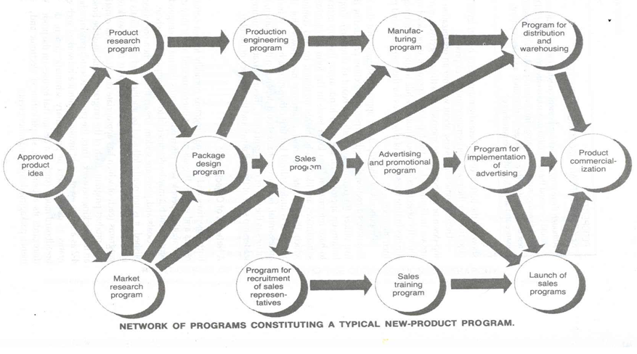
PROGRAMS
Programs are a complex of goals, polices, procedures, rules, task assignments, steps to be taken, resources to be employed and other elements necessary to carry out a given course of action; they are ordinarily supported by budgets.

Slide 23
BUDGETS
Budgets are the statement of expected results expressed in numerical terms , referred as numberized programs
Can be in terms of--- no of labour hours, units of production, financial terms, machine-hours,
Budgets usually implements a program , it may in itself be a program.
Variable or flexible budgets—depends on level of output
Program budgets—the agencies and each dept. Within the agencies identifies the goals. Zero based budgets—combination of variable and program budgets.

Slide 24
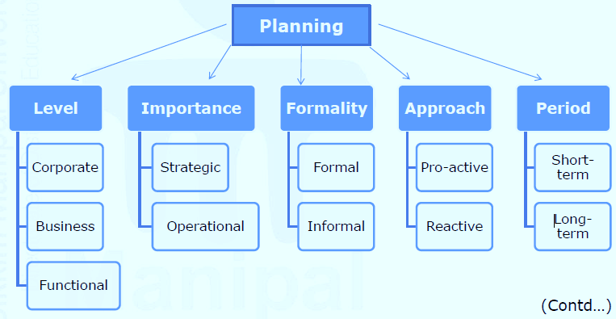
Types of Planning
•Planning can be classified from different perspectives. The figure below depicts the perspectives of planning.

Slide 25
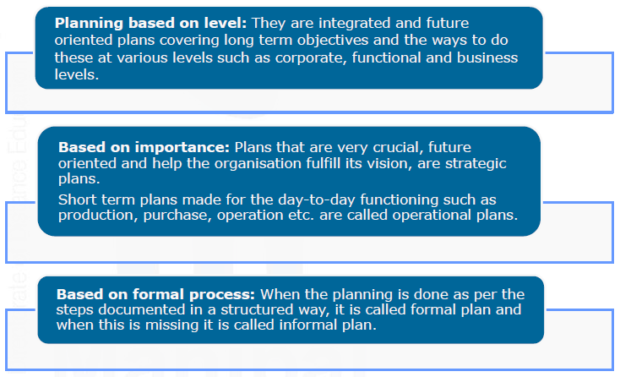
Types of Planning

Slide 26
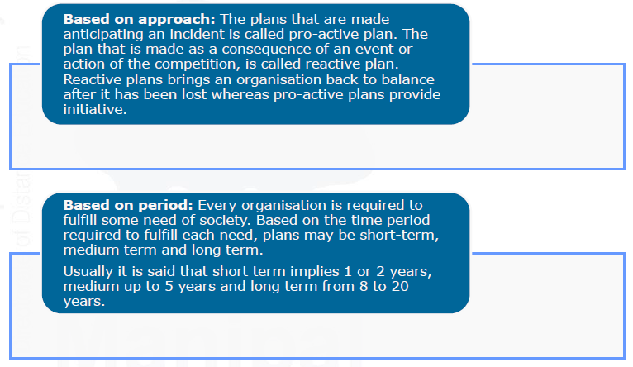
Types of Planning

Slide 27
Types of Plans
BREADTH TIME SPECIFICITY FREQUENCY OF USE FRAME OF USE
Strategic Long term Directional Single use
Tactical Short term Specific Standing

Slide 28
The most popular ways to describe plans are by their breadth (strategic versus tactical), time frame (long term versus short term), specificity (directional versus specific), and frequency of use (single use versus standing). These classifications are not mutually exclusive.

Slide 29
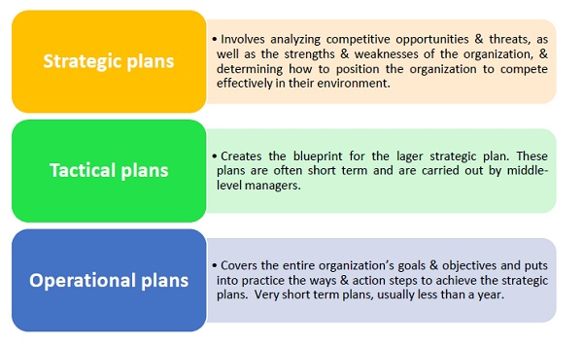

Slide 30
Upper-level managers develop strategic plans that apply to the entire organization, establish overall objectives, and position the organization within its environment.
Lower-level managers focus on tactical plans that specify how the overall objectives will be achieved. These plans differ in time frame and scope.
Operational plans are limited in scope and are measured daily, weekly, or monthly; strategic plans are broader, less specific and encompass five or more years.

Slide 31
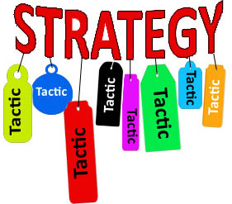

Slide 32
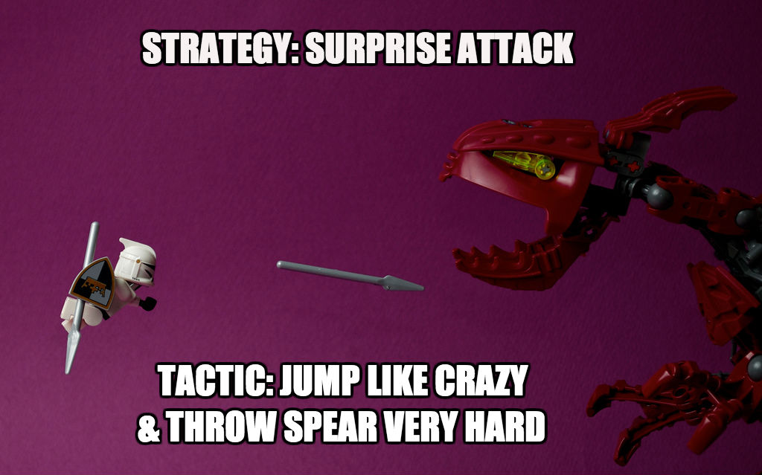

Slide 33
Example:
Finding a Job
Perhaps your goal is to find a new job as part of a long-term plan for financial stability. There are several different strategies you can use to find a job, including:
Using your current skills to find a new job
Becoming an apprentice for a trade
Going to college for a new career.
If you decide on a strategy to use your current skills in a different job, then your tactics might include:
Updating your résumé
Telling your friends that you want a new job so they can help you
Looking at job postings in newspapers or on the Internet.
In this situation, as in most cases, you’ll probably use a few different tactics as part of your strategy to find a job. And in the process, you might decide that some tactics don’t work well so you’ll abandon them and try new tactics.

Slide 34
Strategic Planning
Strategic plans
Apply broadly to the entire organization.
Establish the organization’s overall objectives.
Seek to position the organization in terms of its environment.
Provide direction to drive an organization’s efforts to achieve its goals.
Serve as the basis for the tactical plans.
Cover extended periods of time.
Are less specific in their details.

Slide 35
Tactical plans (operational plans)
Apply to specific parts of the organization.
Are derived from strategic objectives.
Specify the details of how the overall objectives are to be achieved.
Cover shorter periods of time.
Must be updated continuously to meet current challenges.

Slide 37
Specific plans
Plans that have clearly defined objectives and leave no room for misinterpretation.
“What, when, where, how much, and by whom” (process-focus)
Eg: Lesson Plan
Directional plans
Flexible plans that set out general guidelines.
“Go from here to there” (outcome-focus)

Slide 38
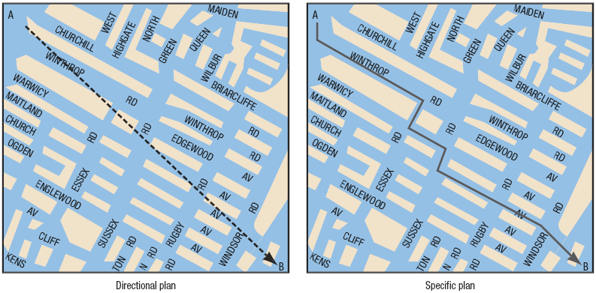
Directional versus Specific Plans

Slide 39
Single-use plans
A plan that is used to meet the needs of a particular or unique situation
Single-day sales advertisement
Standing plan
A plan that is ongoing and provides guidance for repeatedly performed actions in an organization
Customer satisfaction policy

Slide 40
Systems approach to Management

Slide 41
